Slide 1
CUDA programing
Kyung Bae Jang
https://youtu.be/nRmNMzJLjoU

Slide 2
SIMECK
SIMECK - C
SIMECK - CUDA C
SIMECK - CUDA PTX
Performance

Slide 3
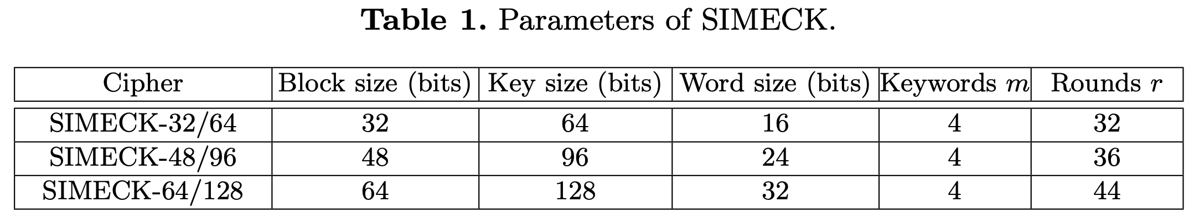
SIMECK
A family of lightweight block ciphers (SPECK + SIMON)
The round function and the key schedule are based on the Feistel architecture

Slide 4
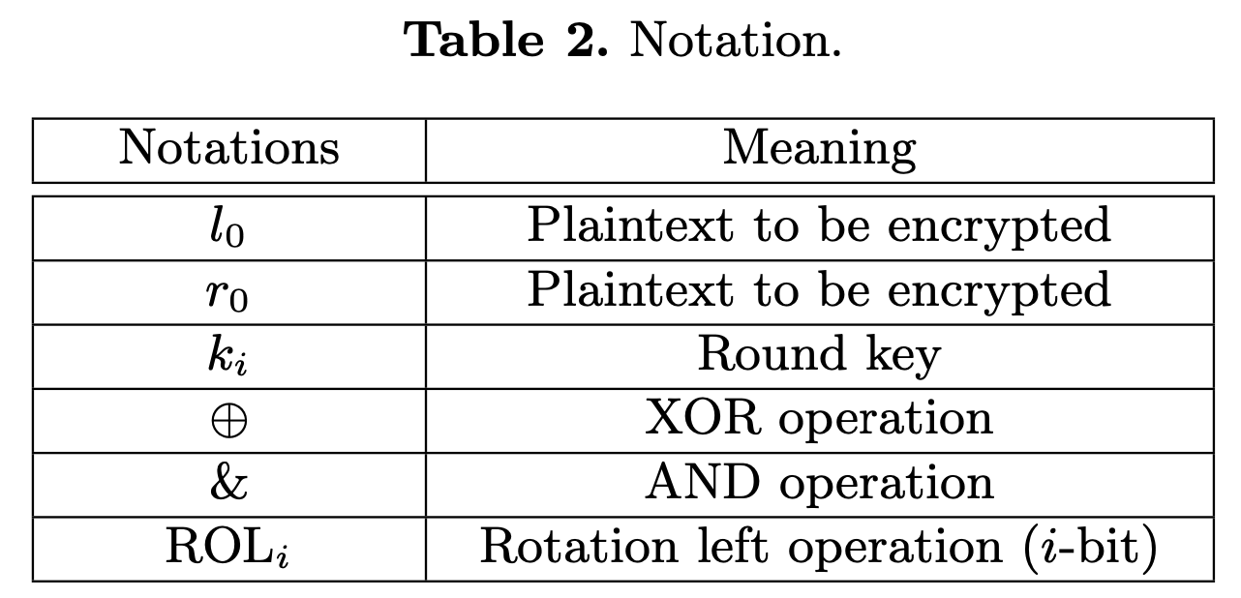
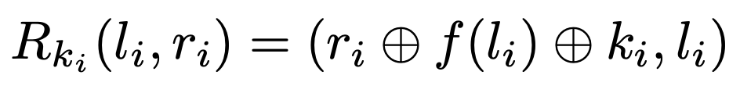
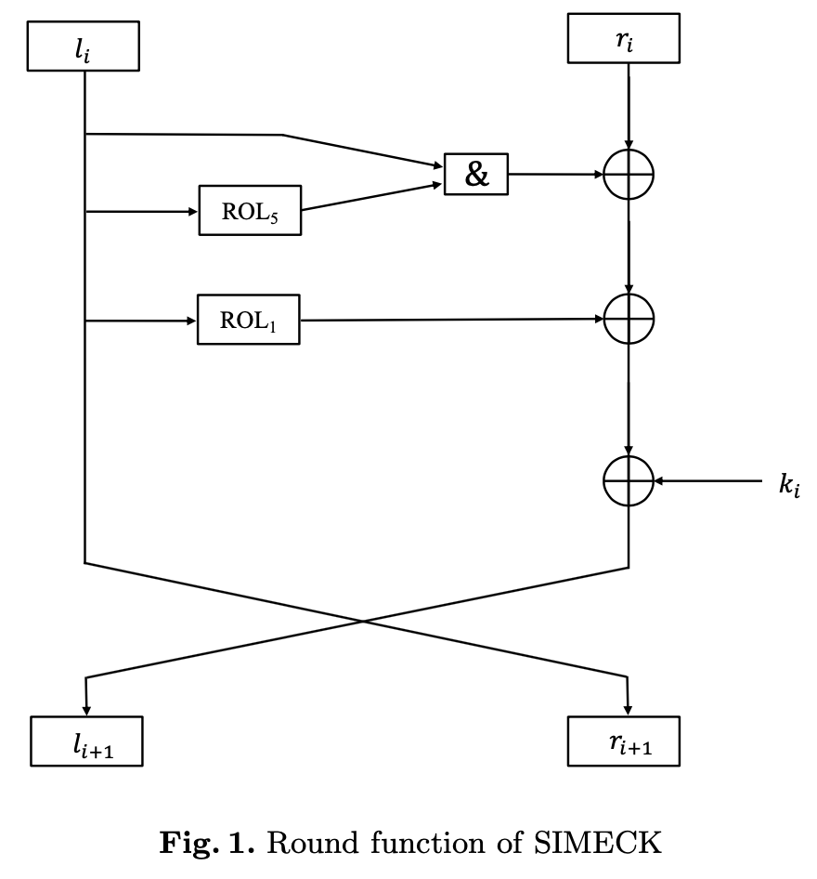
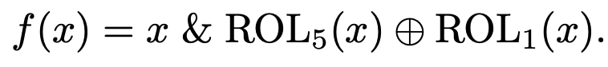
SIMECK
Round function
Similar with SIMON

Slide 5
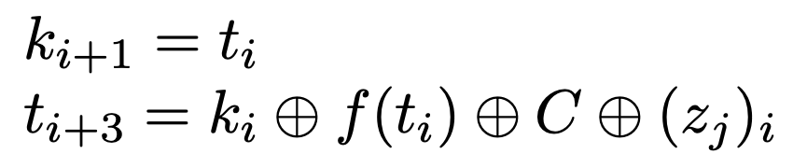
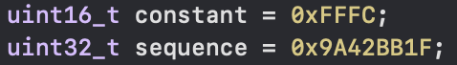
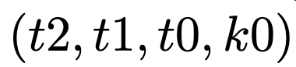
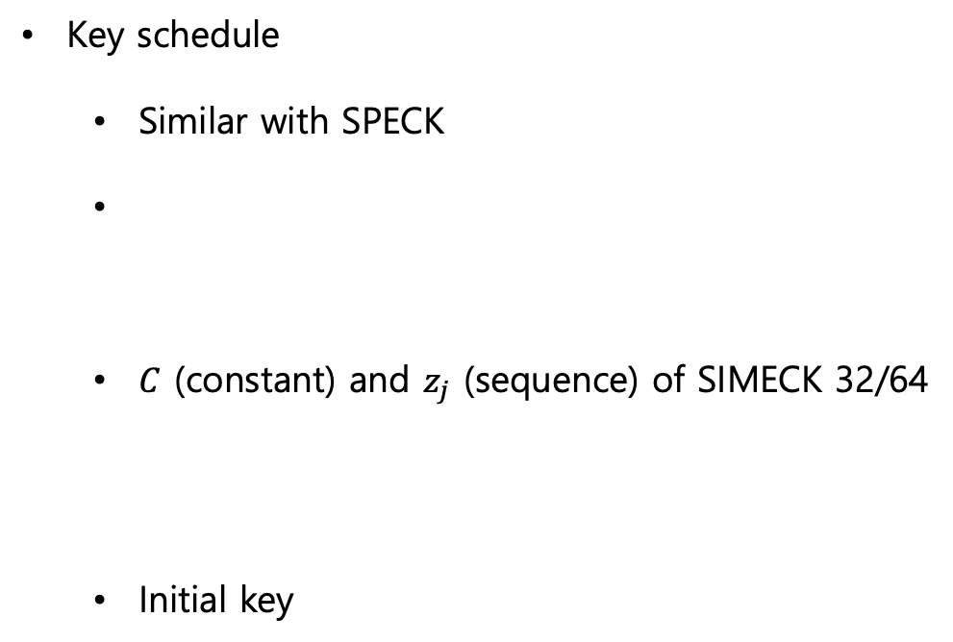
SIMECK
Key schedule
Similar with SPECK
$C$ (constant) and $z_{j}$ (sequence) of SIMECK 32/64
Initial key

Slide 6
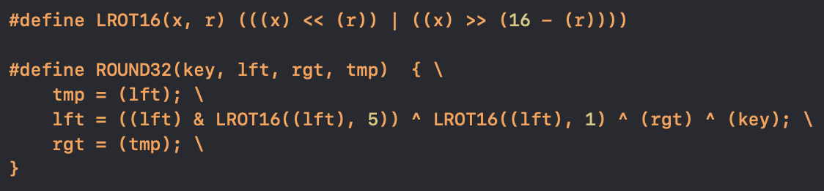
SIMECK - C
SIMECK 32/64
Round function and Rotation Left

Slide 7
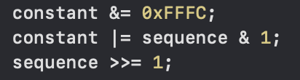
SIMECK - C
SIMECK 32/64
Key schedule
Similar with round function
*
Initial key :

Slide 8
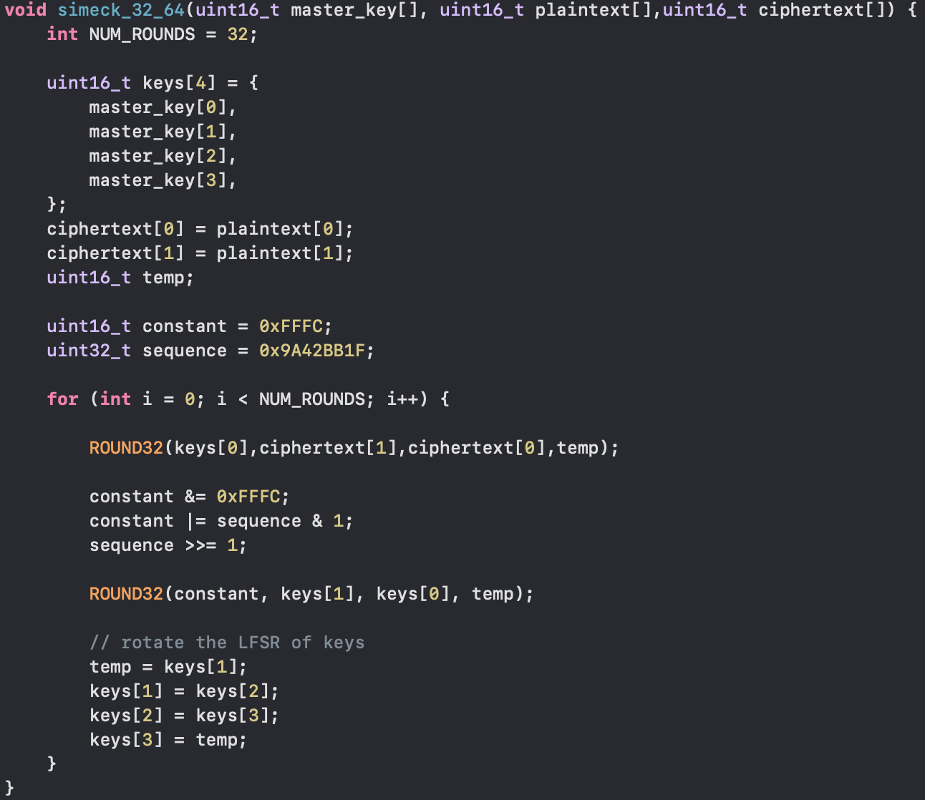
SIMECK - C
SIMECK 32/64

Slide 9
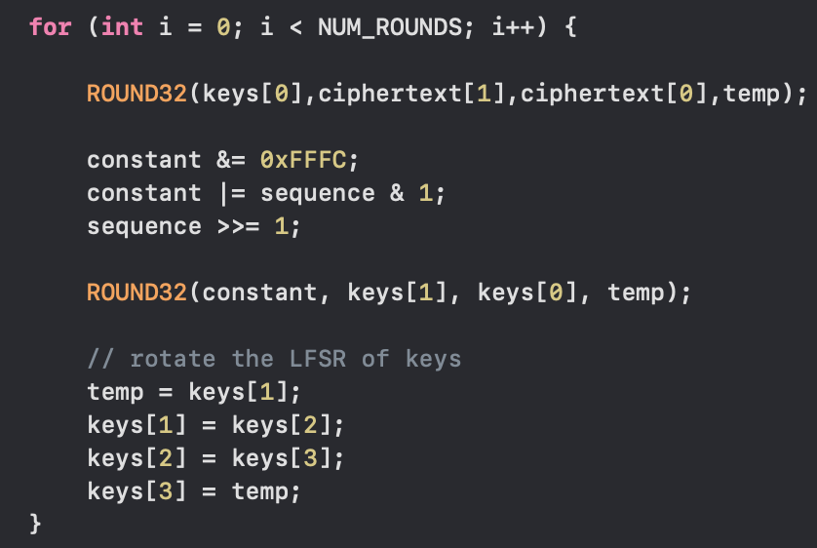
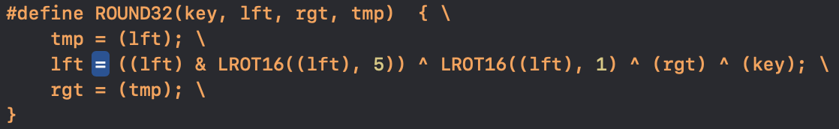
SIMECK – CUDA C(1)
SIMECK 32/64
Round function + key schedule
Frequent memory access GPU & CPU → Low performance
Value update
Key use in round fuction
Key update in key schedule
lft
rgt

Slide 10
SIMECK – CUDA C(2)
SIMECK 32/64
Encrypt multiple messages(1024 x 76) with multiple keys (1024 x 76)
allocate GPU memory
CPU → GPU

Slide 11
SIMECK – CUDA C(2)
Parallel Encryption (76 block , block per thread : 1024)
GPU → CPU
CPU Performance
CUDA C Performance

Slide 12
SIMECK – CUDA PTX
__global__ void Round part (PTX), key schedule part (omitted)
CUDA C Performance
CUDA My PTX performance
Faster

Slide 13
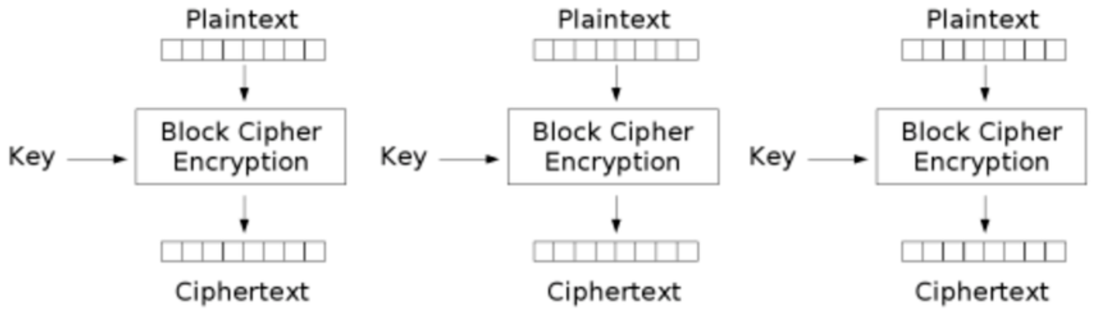
Performance
Parallel encryption (1024 x 76)
…
CPU Performance
CUDA C Performance
CUDA My PTX performance
Faster

Slide 14
Thank you

